Slide 1
Programming fundamentals
Section 6

Slide 2
Iteration Statements
Iteration statements (also called loops) allow a set of instructions to be executed repeatedly until a certain condition is reached.
For loop
While
do-while

Slide 3
While Loop
General form:
The condition may be any expression, and true is any nonzero value.
The loop iterates while the condition is true. When the condition becomes false, program control passes to the line of code immediately following the loop.
while (condition) statement;

Slide 4
While Loop
Like for loops, while loops check the test condition at the top of the loop, which means that the body of the loop will not execute if the condition is false.
- Counter-Controlled while Loops
Sentinel-Controlled while Loops
Flag-Controlled while Loops

Slide 5
Counter-Controlled while Loops
If you know exactly how many pieces of data need to be read, the while loop becomes a counter-controlled loop

Slide 6
Counter-Controlled while Loops(Example)
Print the numbers 1 through 100 on the screen using while loop
#include <iostream> using namespace std; void main() {int x = 1; while (x <= 100) {cout << x << endl; x++;} system("Pause"); }

Slide 7
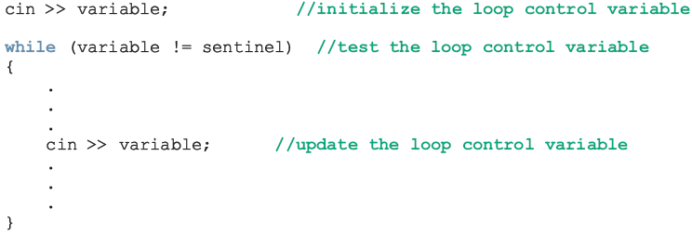
Sentinel-Controlled while Loops
Sentinel variable is tested in the condition and loop ends when sentinel is encountered

Slide 8
Sentinel-Controlled while Loops(Example)
#include <iostream> using namespace std; void main() { char ch='s'; while (ch != 'A') cin >> ch; system("Pause"); }

Slide 9
Sentinel-Controlled while Loops(Example)
#include<iostream> using namespace std; void main() { char op = ' '; int num1, num2; while (op != '@') { cout << "enter 2 numers "; cin >> num1 >> num2; cout << "enter operation "; cin >> op; switch (op) { case'+': cout << num1 + num2<<endl ; break; | case '-': cout << num1 - num2 << endl; break; case '*': cout << num1 * num2 << endl; break; case '/': cout << num1 / num2 << endl; break; } } system("Pause"); }

Slide 10
Flag-Controlled while Loops
A flag-controlled while loop uses a bool variable to control the loop

Slide 11
Flag-Controlled while Loops(Example)
#include <iostream> using namespace std; void main() {bool found = false; int x = 1; while (!found) {x++; if (x >= 20) found = true;} cout << x<<endl; system("Pause");}

Slide 12
do-while Loop
General form:
Unlike for and while loops, which test the loop condition at the top of the loop, the do-while loop checks its condition at the bottom of the loop. This means that a do-while loop always executes at least once.
do { statement; } while (condition);

Slide 13
While vs. do-while
#include <iostream> using namespace std; void main() { char ch='A'; do { cin >> ch; } while (ch != 'A'); system("Pause"); } | #include <iostream> using namespace std; void main() { char ch = 'A'; while (ch != 'A') cin >> ch; system("Pause"); }

Slide 14
Example
C++ Program to find factorial of a number using for loop
(Factorial on n = 1*2*3*...*n)
#include <iostream> using namespace std; void main() { int i, n, factorial = 1; cout << "Enter a positive integer: "; cin >> n; for (i = 1; i <= n; ++i) { factorial *= i; // factorial = factorial * i; } cout << "Factorial of " << n << " = " << factorial<<endl; system("Pause"); }

Slide 15
Example
C++ Program to find sum of any 5 numbers using while loop
#include <iostream> using namespace std; void main() { int x=1,num, sum=0; while (x <=5) { cin>>num; sum += num; x++; } cout << "sum = " << sum << endl; system("Pause"); }

Slide 16
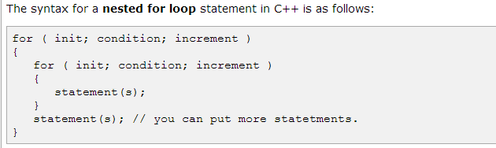
Syntax for nested loops

Slide 17
Example
#include<iostream> using namespace std; void main() { for (int i = 1; i <=5; i++) { for (int j = 1; j <= i; j++) { cout << j; } cout << endl; } system("Pause"); }

